Slide 1





SPRING BOOT PROJECT
LECTURE - 1

Slide 2

Today’s Agenda
What Is Lombok ?
How Lombok Is Used In Spring Boot ?
Using Lombok Annotations
@Getter,@Setter Annotations
Generating Constructors
Generating toString(), equals() and hashCode()

Slide 3
What Is Lombok ?
Lombok is a Java library .
It provides simple annotations which help a programmer reduce boilerplate code, such as:
getters
setters
constructors
toString() etc.
So we can say it makes the code cleaner and more readable.

Slide 4
How Is Lombok Used In Spring Boot ?
Lombok is widely used in Spring Boot applications to simplify Java classes, particularly for DTOs, Entities, and Configuration classes.
To use Lombok we need to take 2 steps only:
Create a new Spring Boot Project and add the lombok dependency in pom.xml.
Install the lombok plugin.

Slide 5
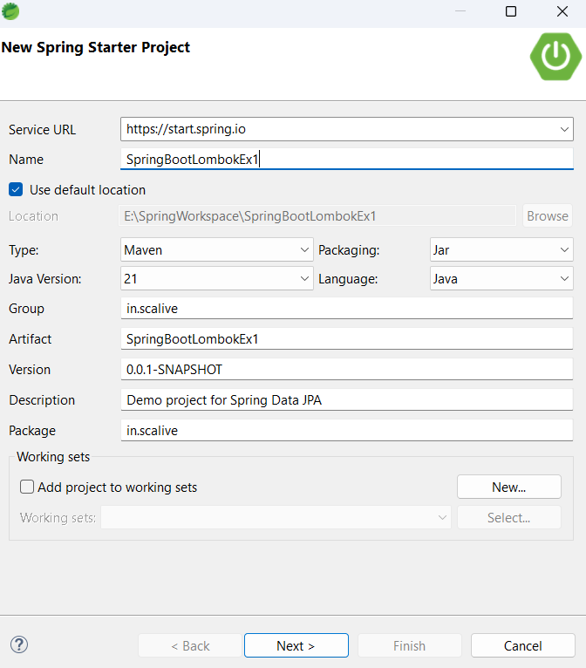
Step 1- Add Lombok Dependency

Slide 6
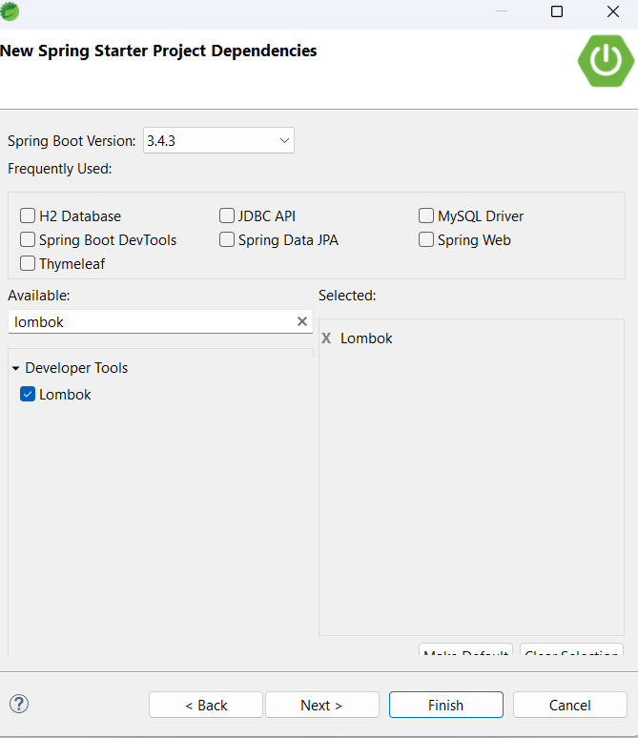
Step 1- Add Lombok Dependency

Slide 7
The Generated pom.xml
<dependency>
<groupId>org.projectlombok</groupId>
<artifactId>lombok</artifactId>
<optional>true</optional>
</dependency>

Slide 8
Step 2- Install Lombok Plugin For STS
Since STS is based on Eclipse, we need to install the Lombok plugin manually:
Download Lombok JAR
Go to Lombok's official site and download the latest lombok.jar.
Copy jar inside STS folder
Copy this jar inside the STS installation directory alongside sts.exe.
Run Lombok Installer
Open a terminal , navigate to sts directory and run the following:
java -jar lombok.jar
It will detect our STS installation and provide an "Install/Update" button. Click it.

Slide 9
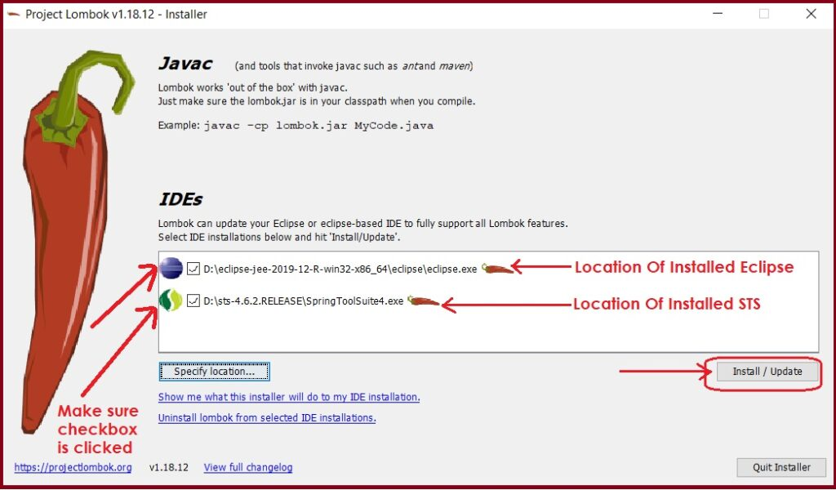
Step 2- Install Lombok Plugin For STS
Make sure to restart the IDE after installation.

Slide 10
Using Lombok Annotations
We use getters and setters to achieve the encapsulation in Java.
So basically we declare variables as private and provide public methods to access and update those private variables.

Slide 11
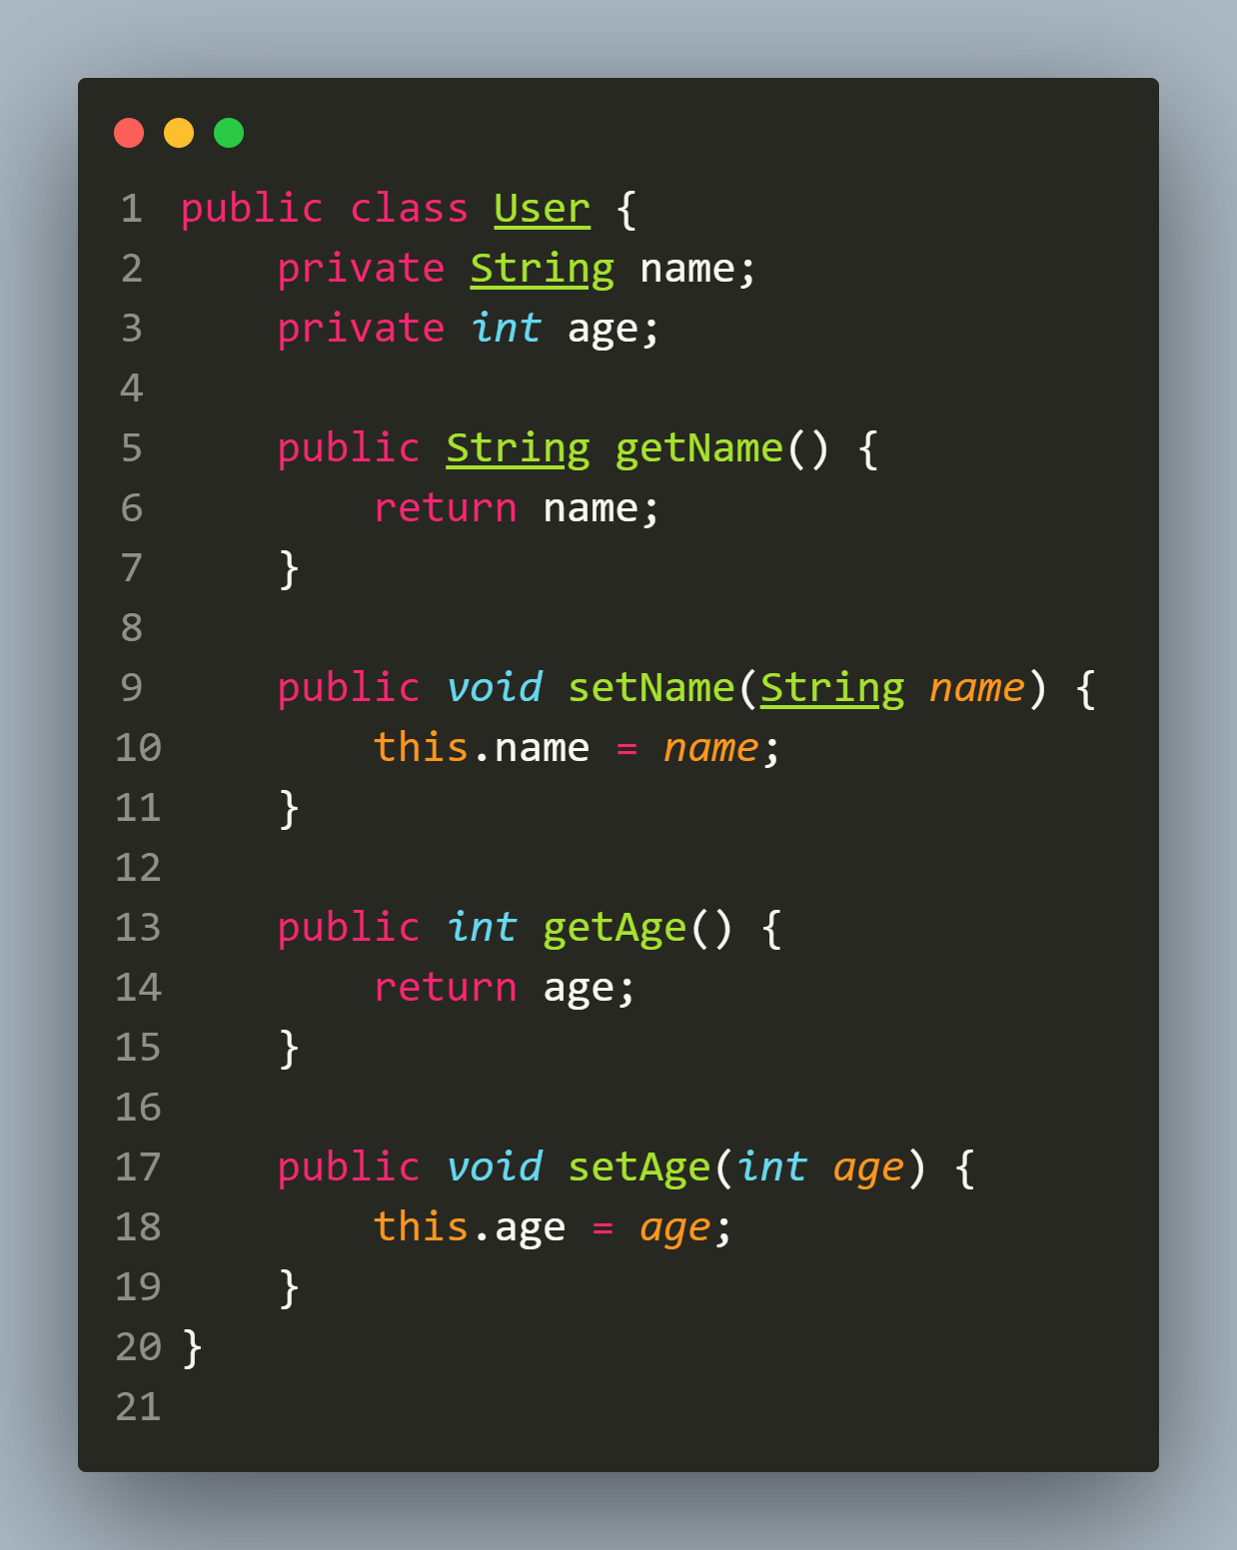
Without Lombok

Slide 12
Using @Getter And @Setter
The @Getter and @Setter annotations automatically generate the getter and setter methods for the fields in our class.
Without Lombok, we would have to write these methods manually, but with Lombok, a single annotation can replace all of them

Slide 13
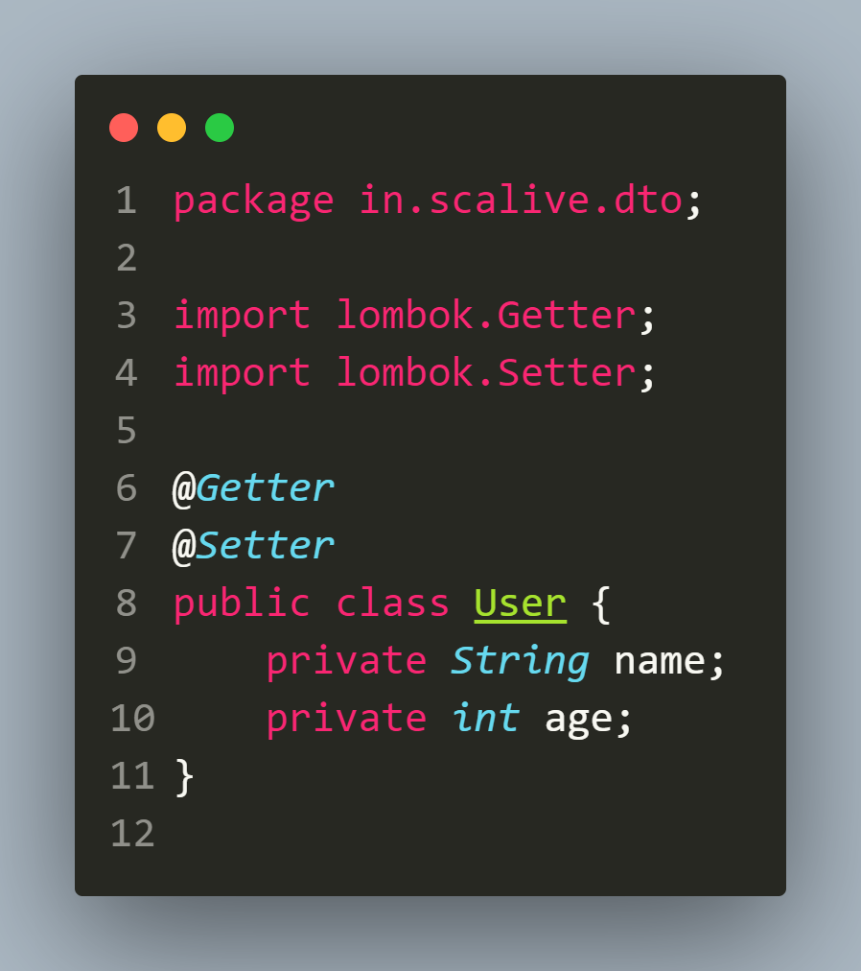
With @Getter & @Setter
Lombok automatically creates getters and setters.
We don't need to write them manually.

Slide 14
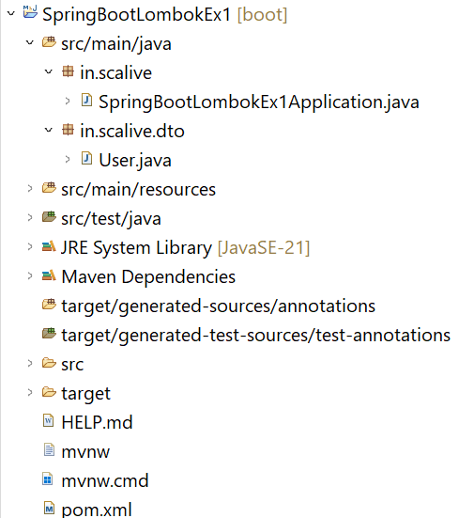
Folder Structure

Slide 15
User.java
package in.scalive.dto;
import lombok.Getter;
import lombok.Setter;
@Getter
@Setter
public class User {
private String name;
private int age;
}
In case you get error in these annotations then do enable annotation processing in your project

Slide 16
SpringBootApplication
package in.scalive;
import org.springframework.boot.SpringApplication;
import org.springframework.boot.autoconfigure.SpringBootApplication;
import in.scalive.dto.User;
@SpringBootApplication
public class SpringBootLombokEx1Application {
public static void main(String[] args) {
SpringApplication.run(SpringBootLombokEx1Application.class, args);
User user=new User();
user.setName("Ajay");
user.setAge(24);
System.out.println("Name:"+user.getName());
System.out.println("Age:"+user.getAge());
}
}

Slide 17
Output
Name:Ajay
Age:24

Slide 18
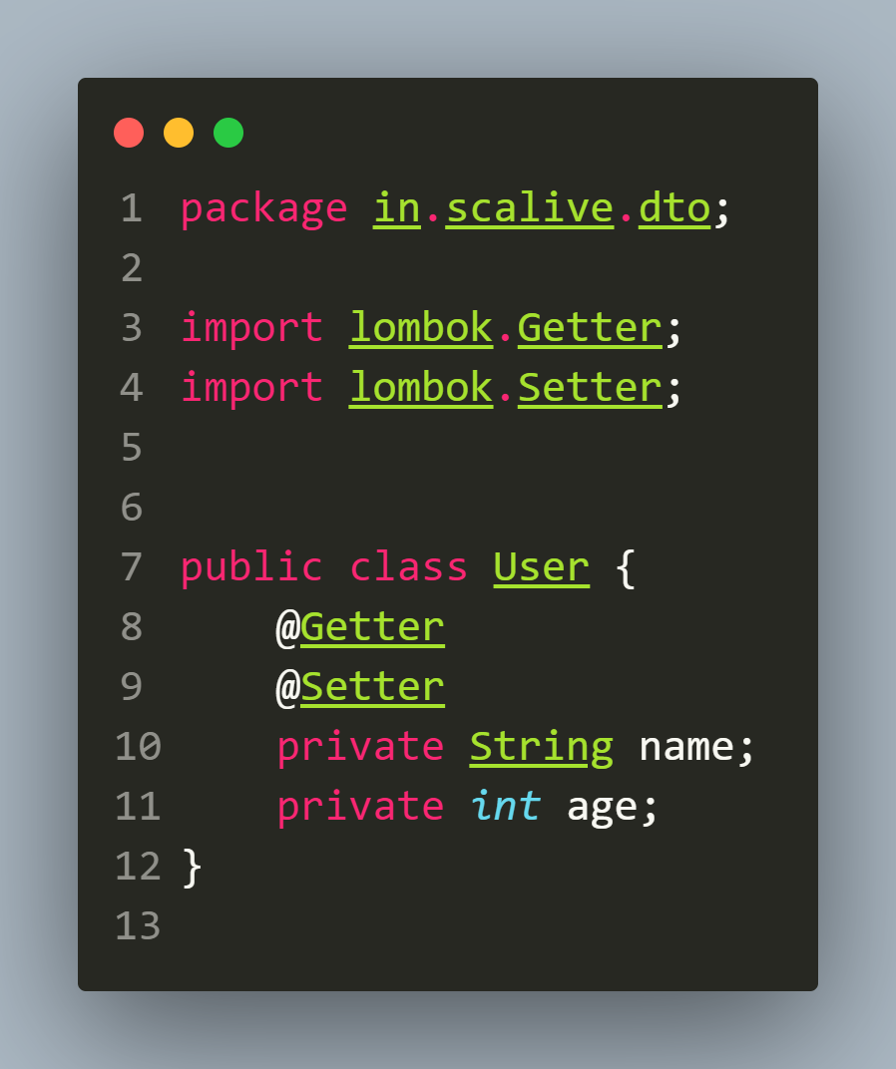
Important Points About @Getter & @Setter
We can use @Getter and @Setter at field level also.
In this case as expected they will generate setter and getter methods for that particular field only
Lombok will only generate setter and getter for name and not for age

Slide 19
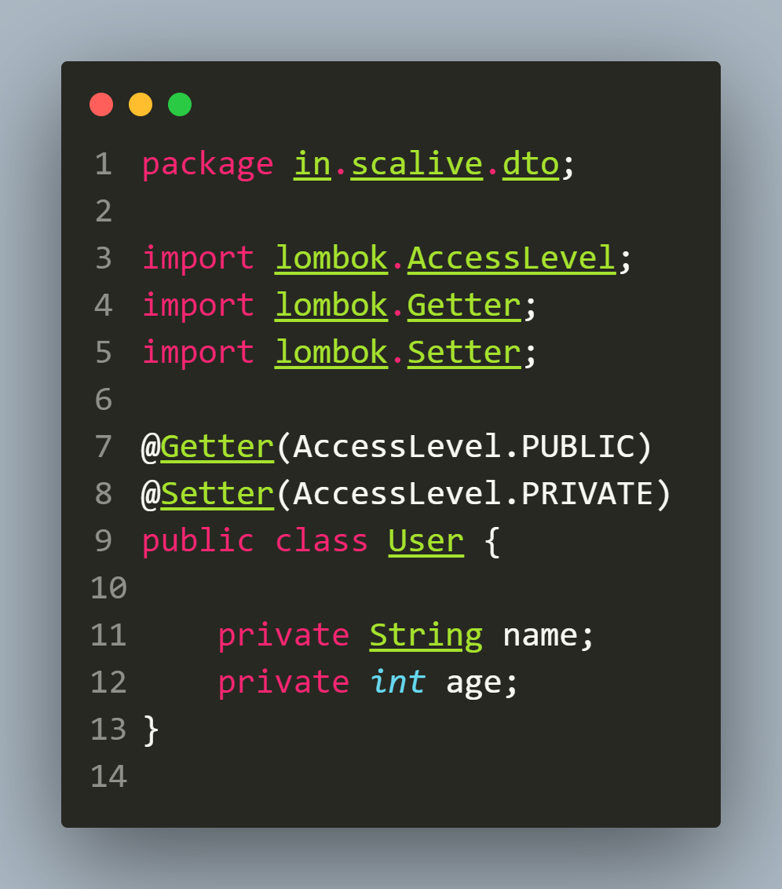
Important Points About @Getter & @Setter
We can also control the visibility of these methods:
Lombok will only generate public getters for both fields but setters will be private

Slide 20
Using Lombok For Constructors
Lombok provides three annotations to automatically generate constructors for our class.
They are:
@NoArgsConstructor: Generates a no-argument constructor.
@AllArgsConstructor: Generates a constructor with all fields as parameters.
@RequiredArgsConstructor: Generates a constructor with required fields as parameters.
The word required fields means final data members of the class.

Slide 21
User.java
package in.scalive.dto;
import lombok.AllArgsConstructor;
import lombok.Getter;
import lombok.NoArgsConstructor;
@Getter
@NoArgsConstructor
@AllArgsConstructor
public class User {
private String name;
private int age;
}

Slide 22
SpringBootApplication
package in.scalive;
import org.springframework.boot.SpringApplication;
import org.springframework.boot.autoconfigure.SpringBootApplication;
import in.scalive.dto.User;
@SpringBootApplication
public class SpringBootLombokEx1Application {
public static void main(String[] args) {
SpringApplication.run(SpringBootLombokEx1Application.class, args);
User user1=new User("Deepak",24);
System.out.println("Name:"+user1.getName());
System.out.println("Age:"+user1.getAge());
User user2=new User();
System.out.println("Name:"+user2.getName());
System.out.println("Age:"+user2.getAge());
}
}

Slide 23
Output
Name:Deepak
Age:24
Name:null
Age:0

Slide 24
Using @ToString
The @ToString annotation generates a toString() method for our class, which is useful for logging and debugging.
Without Lombok, we would have to manually write this method to print the object’s field values.

Slide 25
User.java
package in.scalive.dto;
import lombok.AllArgsConstructor;
import lombok.NoArgsConstructor;
import lombok.ToString;
@ToString
@NoArgsConstructor
@AllArgsConstructor
public class User {
private String name;
private int age;
}

Slide 26
SpringBootApplication
package in.scalive;
import org.springframework.boot.SpringApplication;
import org.springframework.boot.autoconfigure.SpringBootApplication;
import in.scalive.dto.User;
@SpringBootApplication
public class SpringBootLombokEx1Application {
public static void main(String[] args) {
SpringApplication.run(SpringBootLombokEx1Application.class, args);
User user1=new User("Deepak",24);
System.out.println(user1);
User user2=new User();
System.out.println(user2);
}
}

Slide 27
Output
User(name=Deepak, age=24)
User(name=null, age=0)

Slide 28
Using @EqualsAndHashCode
The @EqualsAndHashCode annotation generates equals() and hashCode() methods for our class.
These methods are critical when using objects in collections like Set or when comparing objects.

Slide 29
User.java
package in.scalive.dto;
import lombok.AllArgsConstructor;
import lombok.EqualsAndHashCode;
import lombok.NoArgsConstructor;
import lombok.ToString;
@ToString
@NoArgsConstructor
@AllArgsConstructor
@EqualsAndHashCode
public class User {
private String name;
private int age;
}

Slide 30
SpringBootApplication
package in.scalive;
import org.springframework.boot.SpringApplication;
import org.springframework.boot.autoconfigure.SpringBootApplication;
import in.scalive.dto.User;
@SpringBootApplication
public class SpringBootLombokEx1Application {
public static void main(String[] args) {
SpringApplication.run(SpringBootLombokEx1Application.class, args);
User user1=new User("Deepak",24);
System.out.println(user1);
User user2=new User("Deepak",24);
System.out.println(user2);
System.out.println(user1.equals(user2));
}
}

Slide 31
Output
User(name=Deepak, age=24)
User(name=Deepak, age=24)
true

Slide 32
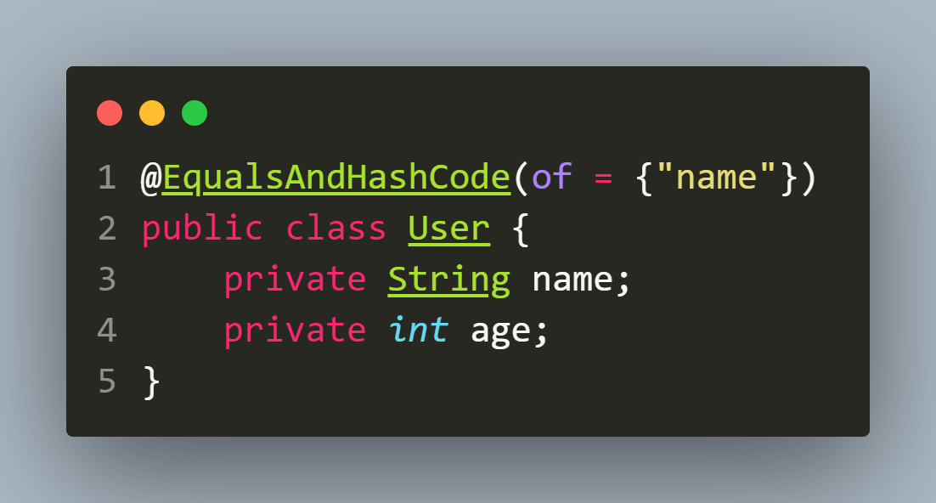
Customizing @EqualsAndHashCode
We can also customize which fields are used for equality checks:
This will make Lombok generate equals() and hashCode() methods that only consider the name field.

Slide 33
Using @Data
The @Data annotation is a combination of several annotations: @Getter, @Setter, @ToString, @EqualsAndHashCode, and @RequiredArgsConstructor.
It’s useful when we want to apply all of these annotations at once to simplify a POJO class.

Slide 34
User.java
package in.scalive.dto;
import lombok.Data;
@Data
public class User {
private String name;
private int age;
}

Slide 35
SpringBootApplication
package in.scalive;
import org.springframework.boot.SpringApplication;
import org.springframework.boot.autoconfigure.SpringBootApplication;
import in.scalive.dto.User;
@SpringBootApplication
public class SpringBootLombokEx1Application {
public static void main(String[] args) {
SpringApplication.run(SpringBootLombokEx1Application.class, args);
User user1=new User();
user1.setAge(24);
user1.setName("Deepak");
System.out.println(user1);
User user2=new User();
user2.setAge(24);
user2.setName("Deepak");;
System.out.println(user2);
}
}

Slide 36
Output
User(name=Deepak, age=24)
User(name=Deepak, age=24)
true

Slide 37
Using @Value
The @Value annotation is used for immutable classes.
It is similar to @Data, but all fields are marked as private final and no setters are generated.
It is useful for creating immutable DTOs.

Slide 38
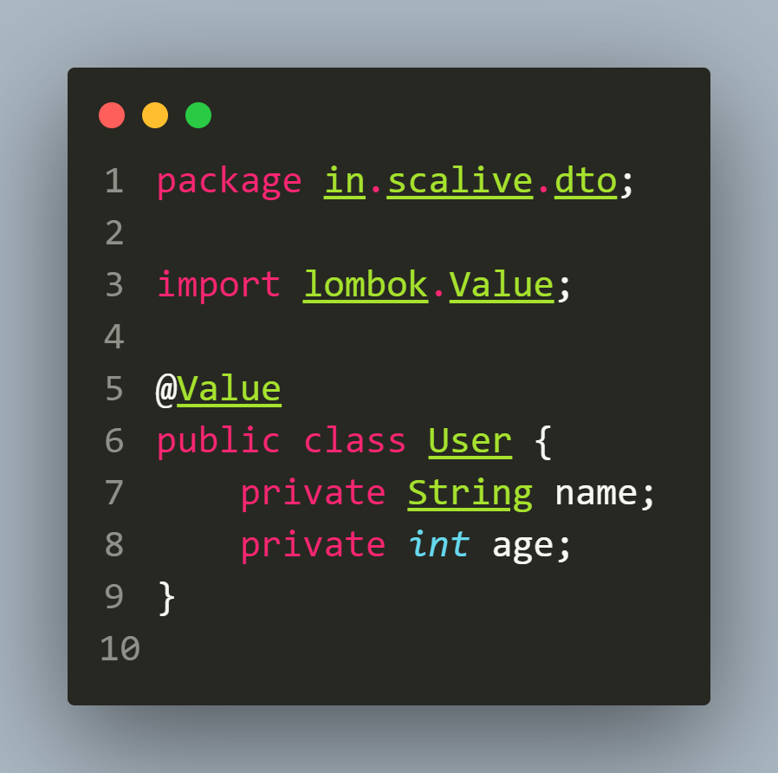
Using @Value
In this case:
Lombok generates a constructor that takes all fields as parameters.
All fields are final and private, making the class immutable.
No setters are generated, ensuring that the object cannot be modified after creation.

Slide 39
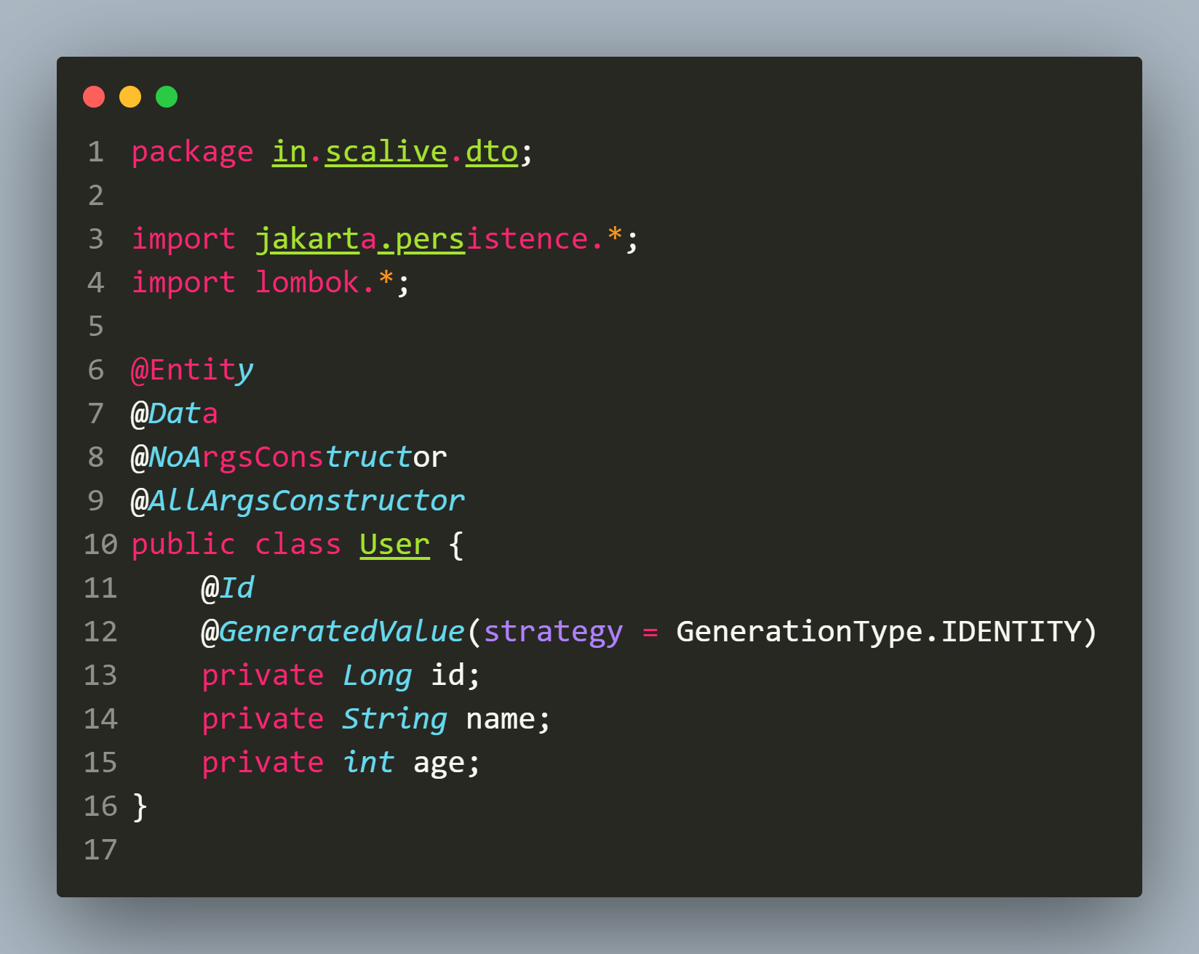
Using LomBok In REST API
No need to write setters, getters, toString(), constructors etc.

Slide 40
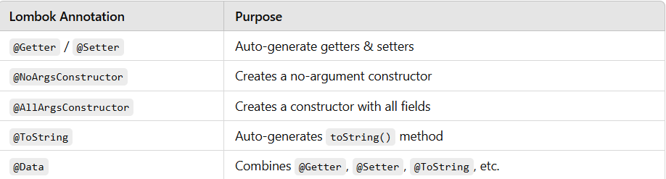
Final Summary

